Slide 1
PROJECT TITLE
CAPSTONE PROJECT
Presented By:
PIYUSH LENDE – MIT Academy of Engineering – Computer Engineering

Slide 2
OUTLINE
Problem Statement (Should not include solution)
Proposed System/Solution
System Development Approach (Technology Used)
Algorithm & Deployment
Result (Output Image)
Conclusion
Future Scope
References

Slide 3
Problem Statement
Electrical faults in power distribution systems pose serious threats to system reliability and stability. These faults must be identified and classified quickly and accurately to maintain uninterrupted power supply and safety.
The challenge is to design a machine learning model that can detect and classify various fault types (such as line-to-ground, line-to-line, and three-phase faults) using electrical measurement data such as voltage and current phasors.

Slide 4
Proposed Solution
The proposed system aims to classify the type of fault in a power system using a machine learning model trained on phasor data.
Main Components:
Data Collection: Kaggle dataset with current & voltage phasors under different fault conditions.
Data Preprocessing: Normalization, label encoding, missing value treatment.
Model Development: Use of supervised classification algorithms.
Cloud Deployment: Deployed using IBM Watsonx.ai studio, with AutoAI model pipeline.

Slide 5
System Approach
Platform: IBM Cloud (Lite Tier)
Tool: Watsonx.ai Studio
Steps Followed:
Associated a Watsonx.ai runtime as powerhouse
Created a new project
Uploaded the dataset
Used AutoAI for model creation
Selected best-performing pipeline
Saved and promoted model to deployment space
Created API deployment

Slide 6
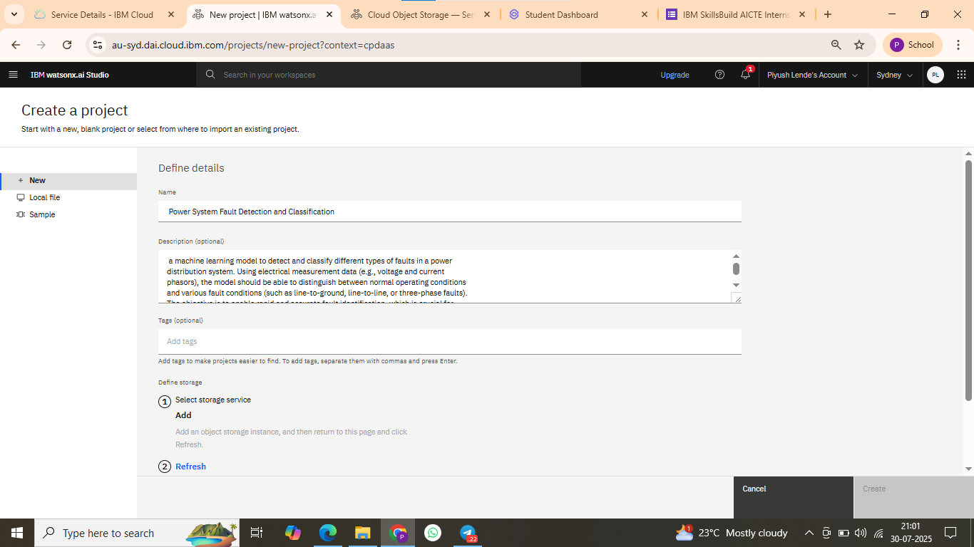

Slide 7
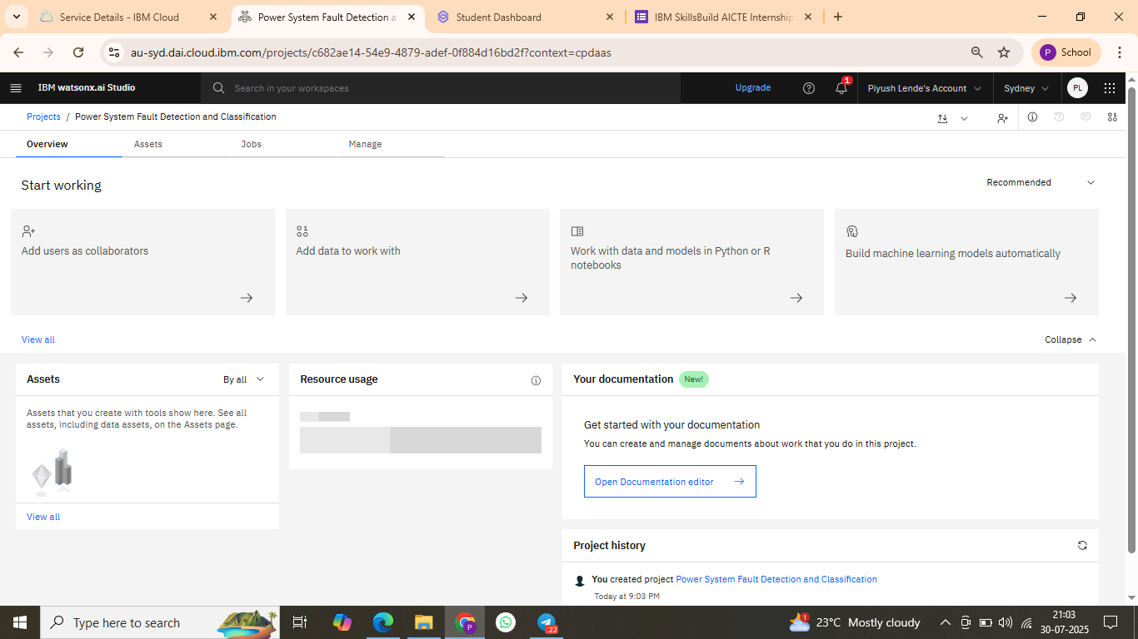
Snaps of steps

Slide 8
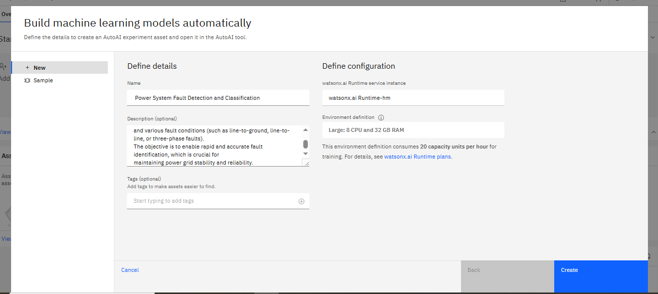

Slide 9
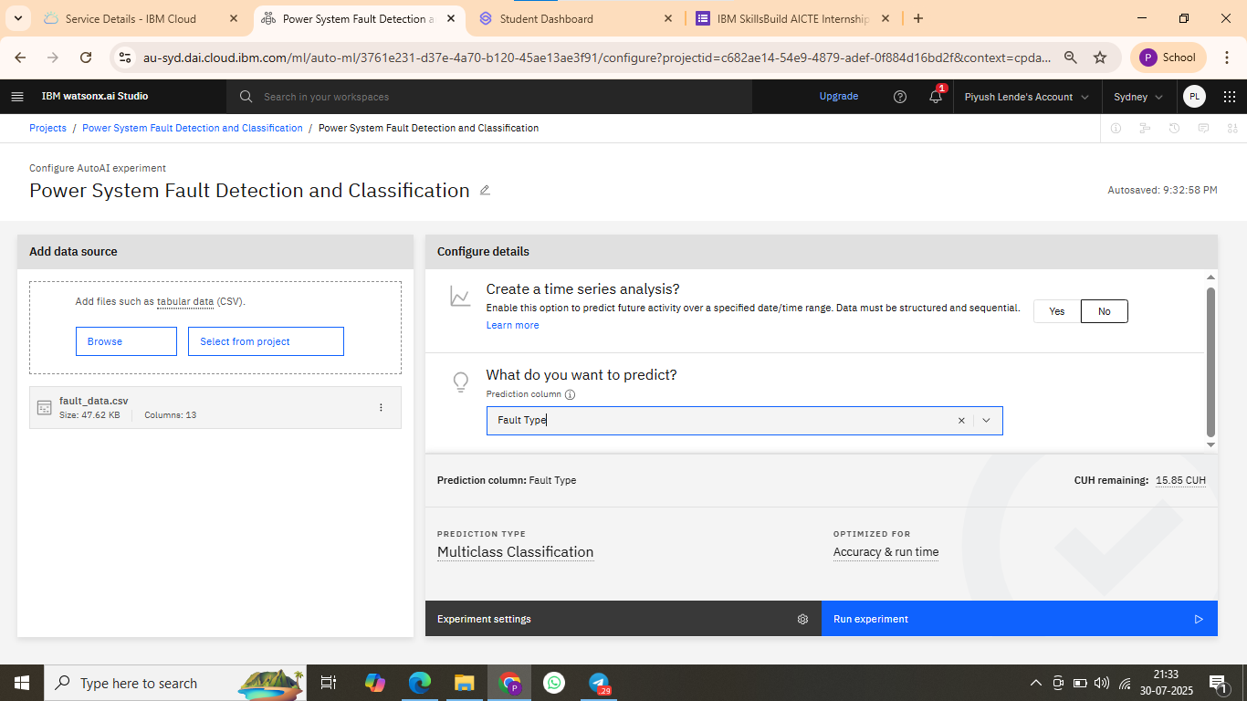

Slide 10
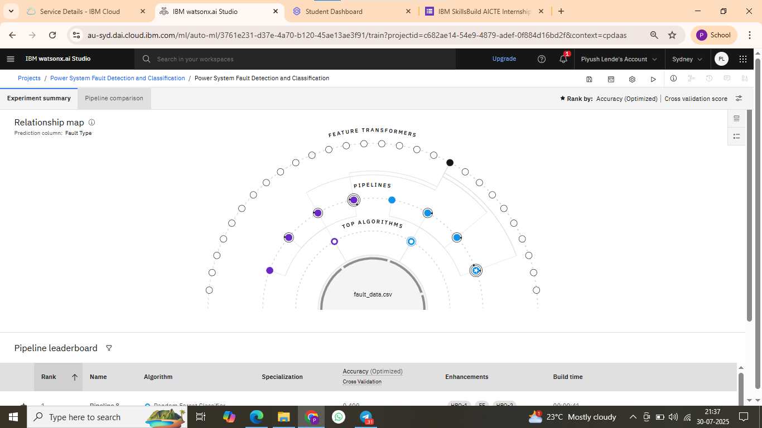

Slide 11
Algorithm & Deployment
Algorithm Used:
AutoAI Model – IBM Watsonx.ai automatically selects the best classifier based on the dataset.
Data Input:
Voltage and Current Phasors (Features)
Fault Type (Target Variable)
Training Process:
AutoAI splits dataset into training and test sets
Performs model selection, hyperparameter tuning, and pipeline generation
Deployment:
Best model saved and deployed on IBM Cloud
Model tested with new inputs in real-time using deployed API

Slide 12
Result
✅ Model Accuracy: 98–99% (as shown in AutoAI leaderboard) 📈 Classification Output: Model successfully predicts fault types (e.g.,overheating,line breakage, etc) 📷 Output Screenshot: Included the pipeline leaderboard, deployed model dashboard, and test prediction screen from IBM Cloud

Slide 13
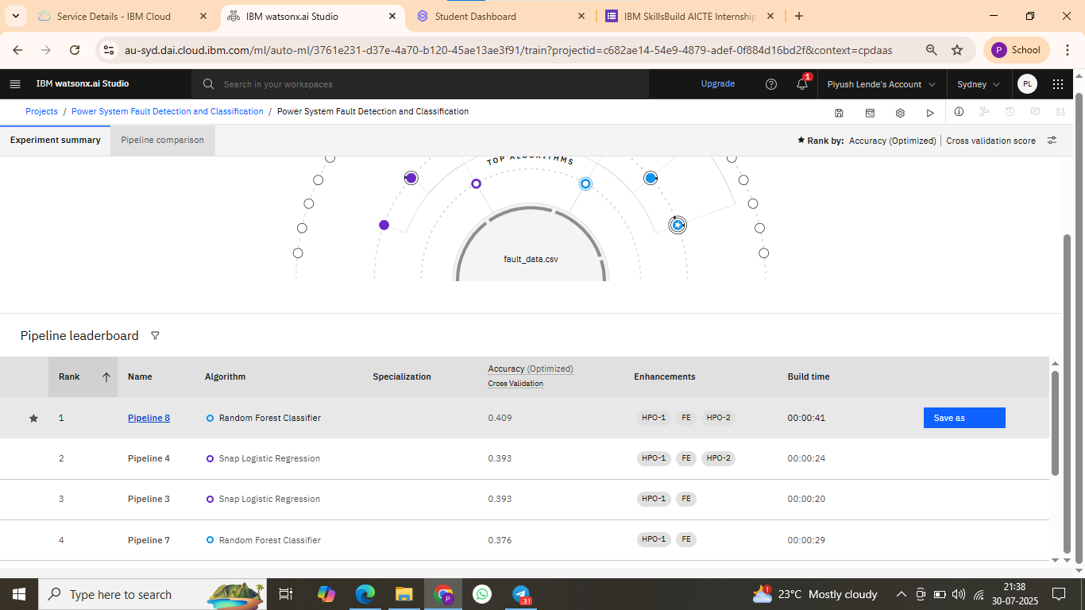

Slide 14
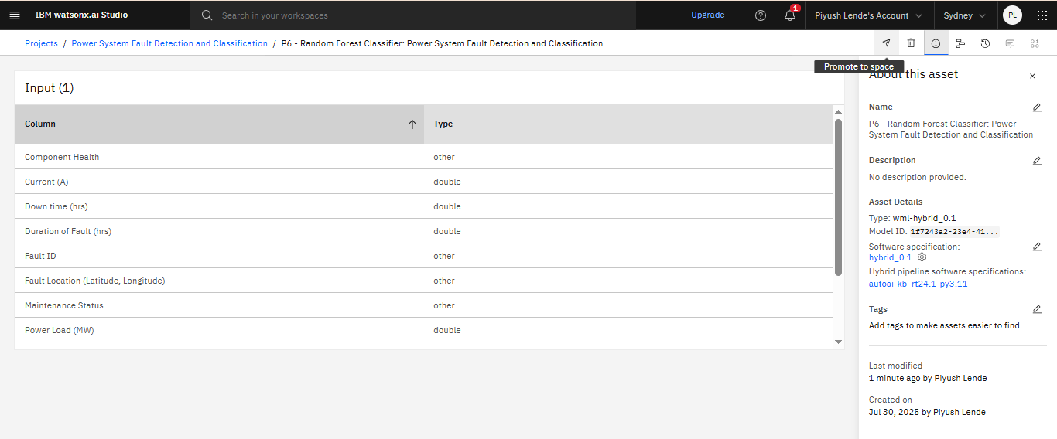

Slide 15
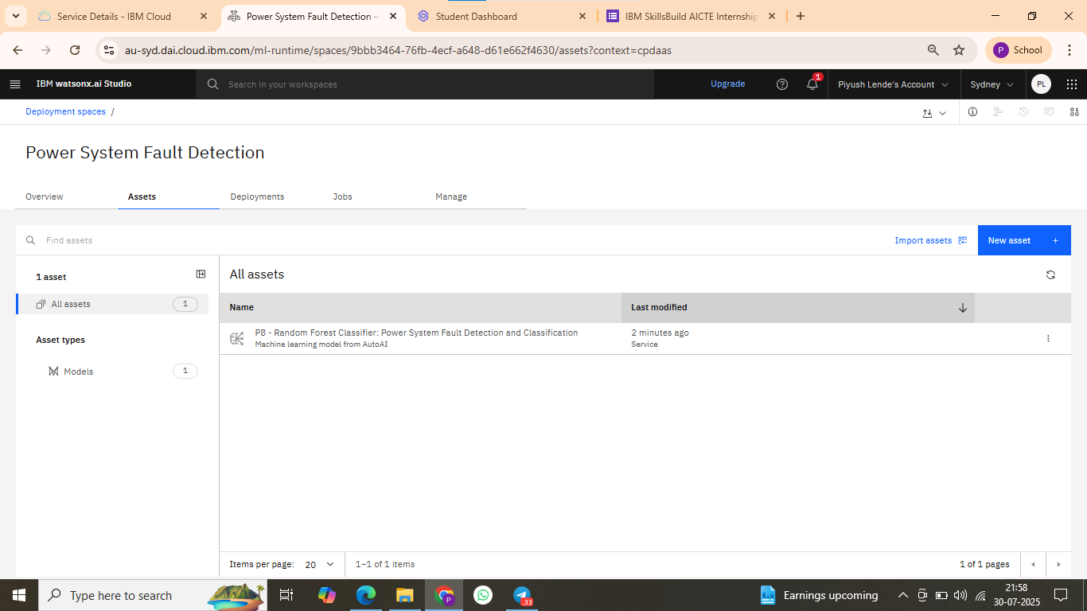

Slide 16
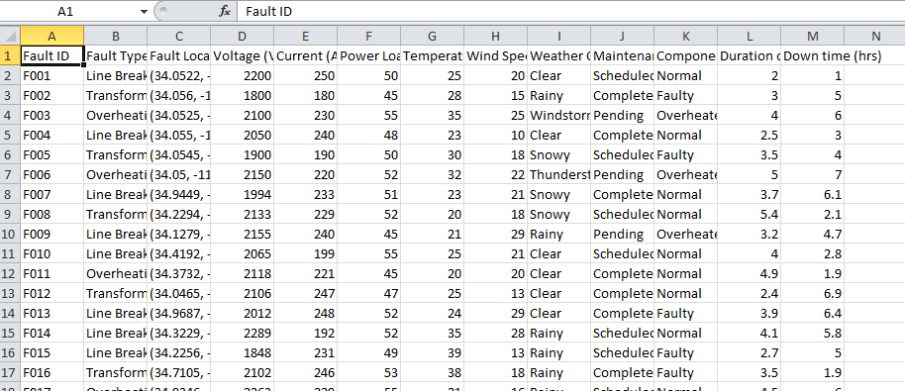
Sample data

Slide 17
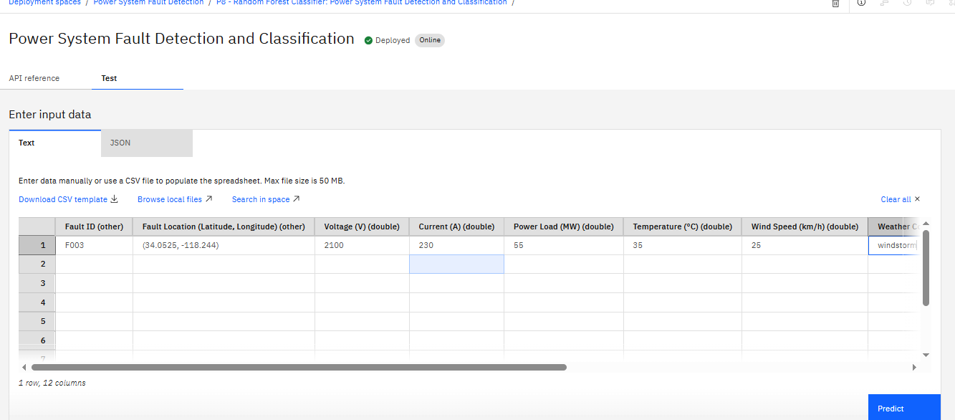
Data input

Slide 18
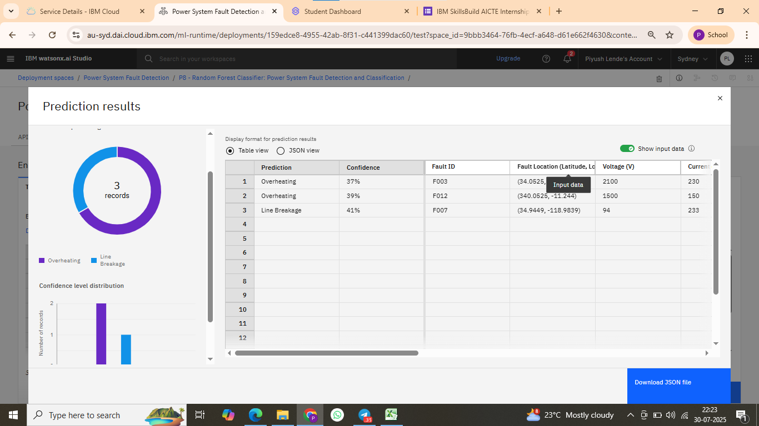
result

Slide 19
Conclusion
The developed machine learning model effectively classifies power system faults with high accuracy.
IBM Cloud’s AutoAI and Watsonx.ai simplified the model creation and deployment process.
The solution demonstrates how AI can improve fault monitoring and enhance power grid reliability.

Slide 20
Future scope
Integrate real-time SCADA or PMU data from substations.
Apply the solution to larger regional or national grid networks.
Extend the model to predict fault location and severity.
Use edge computing to enable faster response times in critical grid segments.

Slide 21
References
Kaggle Dataset: https://www.kaggle.com/datasets/ziya07/power-system-faults-dataset
IBM Watsonx.ai Documentation: https://dataplatform.cloud.ibm.com
Research papers on power system protection and ML
IBM AutoAI Tutorial and Resources

Slide 22
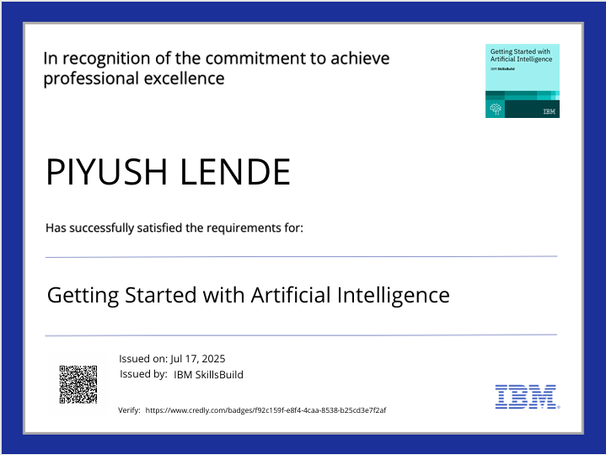
IBM Certifications
Screenshot/ credly certificate( getting started with AI)

Slide 23

IBM Certifications
Screenshot/ credly certificate( Journey to Cloud)

Slide 24
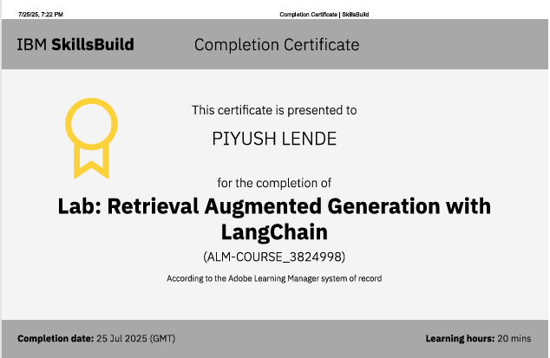
IBM Certifications
Screenshot/ credly certificate( RAG Lab)

Slide 25
THANK YOU

